Slide 1

ATMOSFEAR
The Invisible Killer: Air Pollution
Notes:
Hello everyone. We’re Atmosfear, and we reveal the hidden health impacts of air pollution. Have you ever wondered if air pollution could actually cause more deaths than crime in your own country? we will find out together.

Slide 2
The Real Problem
7 million premature deaths annually (WHO)
Mostly invisible & easy to ignore
A global health crisis, not just an environmental issue
Notes:
every year air pollution is responsible for about 7 million premature deaths, that’s more than violence and traffic accidents combined. The danger is that it’s mostly invisible and easy to ignore. Yet, it remains one of the greatest public health crises of our time that's affecting everyone

Slide 3
Challenges & Pivots
We used IHME Global Burden of Disease dataset
Incomplete & unreliable data
Limited access to hospital records & causes of death
Hard to match city-level health and pollution data
Notes:
We aimed to study pollutants’ health effects at the city level, but data was incomplete and hospital records were inaccessible. So, we focused on one of the most dangerous Pollutants PM2.5 (PM2.5 are tiny air particles (from vehicles, factories, fires, and dust) at the country level and used the trusted IHME Global Burden of Disease datasets for health impact

Slide 4
Our Question
We focused on three part:
PM₂.₅ → Cardiovascular & Respiratory Burdens
Differences by Development Level (2010–2019)
Link to COVID-19 Mortality (2020)
Notes:
We focused on this pollutant, which most strongly affects cardiovascular and respiratory diseases. We asked whether its impact varies by a country’s development level, using data from 2010–2019, then we also looked whether long-term exposure influenced COVID-19 mortality in 2020

Slide 5
Our Findings
1
2
3
4
Development levels Matters Most
Pollution effects are cumulative
PM2.5 hits harder in less developed countries
COVID-19 link is weaker but consistent
Notes:
We found that development level is the most important so less developed countries suffer more. Pollution’s effects accumulate over years, and COVID-19 link was weaker in mortality, due to the complexity of pandemic outcomes

Slide 6

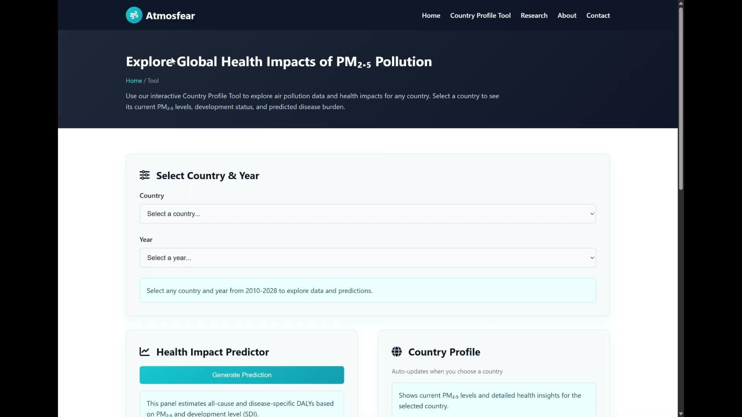
Communicating Our Results
Notes:
To share our results, we built a website with a country profile tool. Here’s a short demo to show how it works and how anyone can explore the data.

Slide 7
Who Are We Reaching?
Health & Environmental orgs
Researchers & Professionals
Why: Key policy actors
How: Via email, policy briefs, Dashboards
Impact: Apply findings to health systems and promote focused interventions
Why: Advance the scientific evidence base
How: Research networks, academic forums
Impact: Expand understanding of pollution health impacts
Notes:
We’re targeting 2 key audience :
public health and environmental organizations.
As key policy actors, we hope to reach them through emails and policy briefs, and that they’ll integrate our tools into health frameworks to guide targeted interventions.
Then researchers and professionals.
By sharing our work on GitHub, we hope they’ll adapt and build on it along the high quality synthetic data that our model generates, to strengthen understanding of pollution health impacts.
And also our website, can give the general public a clear view of pollution harms and an interactive way to explore its impact.

Slide 8




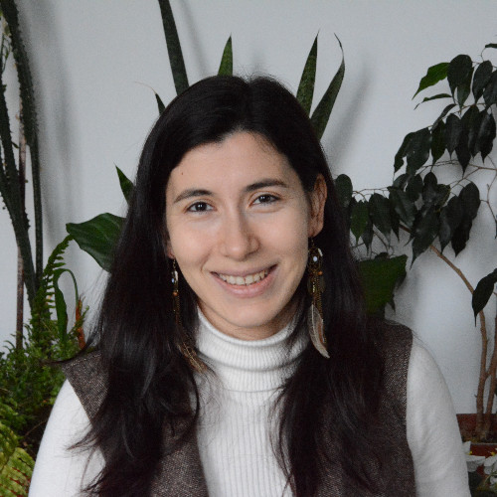

Meet Atmosfear Team
Falaq Youniss
Mohamed Tilal
Said Ibrahim
Lina Khayri
Saliha Kalender
Salih Adam
Hussaini Ahmed, Obay Salih, Mervil Pierre, Ridwan Ayinde, Mithchell Lawensky, Safiya Hashimi
Contact us: atmosfear.group@gmail.com
Notes:
Here is the team members and you can contact us anytime throw our email thank you

